Slide 1
Glasgow Caledonian University
Contract Management Process

Slide 2
Contract Management Strategy
Category A
Collaborative Contracts available to all public bodies. Procured by Scottish Procurement ,ie IT Hardware, Stationery and Utilities
Collaborative Contracts available to public bodies within a specific sector. Procured by Scottish Procurement, APUC, Scotland Excel, NHS National Procurement
Category B
Category C
Local Contracts for use by individual public bodies ie HE & FE institutions
Category C1
Local or regional collaborations between public bodies ie Waste Services Contract & Coach Hire Services

Slide 3
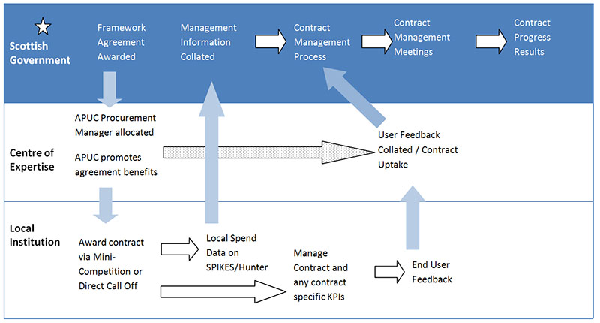
Contract Management Flow Chart
Category A Contracts

Slide 4
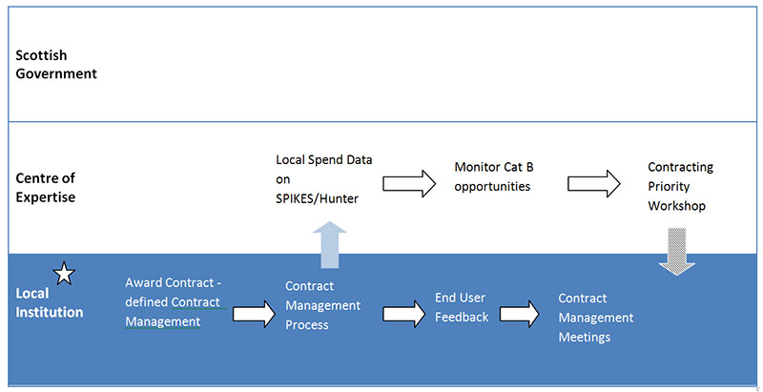
Contract Management Flow Chart
Category C &C1 Contracts

Slide 5
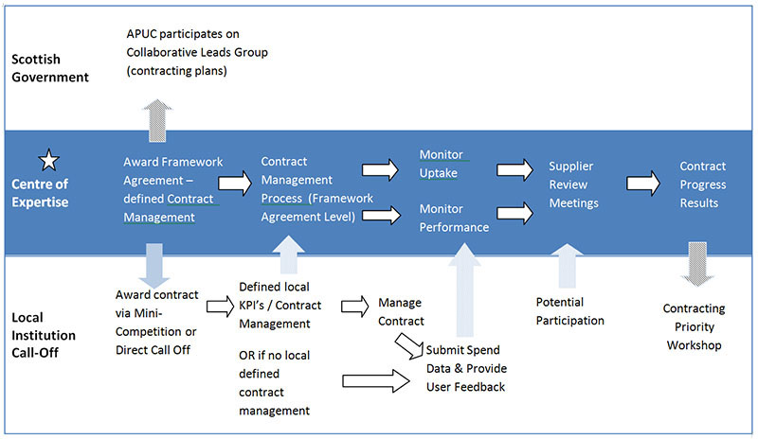
Contract Management Flow Chart
Category B Contracts

Slide 6
Contract Management Flow Chart
Supplier MI
Contract Management Route
Contract – Defined KPI’s
Contract Management Meetings
Review of MI/user data
Information
Information
APUC
Glasgow Caledonian University is ultimately responsible for Contract Management, including conducting Management Meetings, collating and monitoring Supplier Management Information.
Glasgow Caledonian University should take on a role of collating all end user information from the respective end Users and make the information available to the APUC.
Glasgow Caledonian University will be responsible for retrieving User Feedback and using this to develop better supplier relationships for the benefit of the University.
Glasgow Caledonian University
Supplier MI
User Data
/Feedback
End User

Slide 7
Management Route
There are 3 Routes of contract management which are dependent upon the consideration of business and supply risk against the contract value. Every contract will be assessed in the following methodology to determine the level of Contract Management that will be applied. Information will be obtained in the following manner:-
Expenditure Data can be extracted from Spikes Cavell or PECOS, showing Supplier Name, Spend, Category, Department, School etc. to determine the Annual Contract Value
Working with GCU stakeholders it should be possible to position the Risk of Services into an appropriate quadrant.
A process appropriate for each level of Supplier Management will be determined to ensure the right number of meetings are held per annum, looking at the right information and the right people are involved.
Route
H
2
3
3
1
Routine
M
1
2
3
Risk
2
Managed
L
1
1
2
3
Strategic
L
M
H
Value

Slide 8
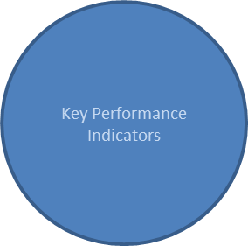
Management Route
Agenda
Review Meetings
Supplier Management Information
Stakeholder Feedback

Slide 9
Routine
Require quarterly submission of Management Information
Carry out annual Contract Review Meetings
Monitor Performance of the Agreement to define KPI’s
Managed
Require quarterly submission of Management Information
Carry out contract review meetings with the Contractor at least annually (optional bi-annually)
Manage and monitor Contractor performance against agreed Key Performance Indicators
Gather feedback on Contractor performance which will be utilised/addressed in Contractor Review Meetings
Monitor performance of the Contract
Strategic
Require quarterly submission of Management Information
Carry out contract review meetings with the Contractor at least bi-annually (optional quarterly)
Manage and monitor Contractor performance against agreed Key Performance Indicators
Gather 360 degree User Feedback on Contractor/User/Procurement performance which will be
utilised/addressed in Contractor review meetings
Maintain and manage all risks and opportunities identified for the agreement
Assess and regularly monitor supplier performance against a balanced scorecard
Monitor performance of the Agreement
Monitor the Market in which the Contractor operates.
Management Route

Slide 10
Tools & Templates
Contract Documentation
To ensure Contract Management is accepted and adopted by our Suppliers, a specific Schedule is included within the Contract, this schedule details, the following information:-
Key representatives
Responsibilities
Meeting Protocol
Reporting
Key Performance Indicators
Key Performance Indicators
During Contract Implementation the content and format of Supplier Management Information will be agreed, the frequency of the Supplier review meetings will be agreed and key personnel identified as Contract Managers.
An example of common KPI’s are attached

Slide 11
Tools & Templates
User Feedback
In order to assess the performance of a Supplier we have developed a User feedback form which once completed can easily be emailed directly to the Procurement Mailbox.
Agenda Templates
Standard Agenda Templates are available for Contract Review Meetings
Routine - Annual Agenda
Strategic/Managed - Monthly/Quarterly/Annual Agenda
Strategic/Managed - Performance Scorecard

Slide 12
Review Meeting Templates
Standard Agenda Templates are available for Contract Review Meetings
Routine Annual Review
Strategic/Managed - Monthly/Quarterly Agenda
Strategic/Managed - Annual Agenda
Strategic/Managed – Balanced Scorecard

